Slide 1
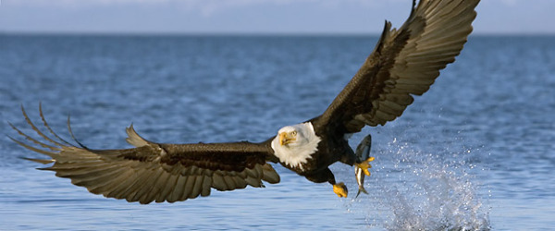
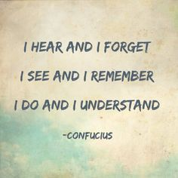
Udaan...
Experiential Programs for Corporates and Professionals
plc
People Live Consultants
www.peoplelive.co.in
jayent@peoplelive.co.in
Ph: 9826062923
Corporate Trainers and HR Partners
Our Programs:
Valley of the Dolls
Herding the Sheep
News Room
Bombay Talkies
Air Force 1
Bridge on the River KWAI
Z KITBAG
Experiential learning is the key driver of anything that we do and fosters an environment of accelerated learning through self discovery and participation.
Your investment in training should have an impact on business outcomes and we make it our priority to ensure that the principles taught are retained and applied on the job.
Experience is a powerful teacher.
Our UDAAN programs are developed to engage participants in “structured experiences” designed to reflect situations in the workplace.
Following the experience, participants use reflective observation to identify
What happened?
What decisions were taken?
What were the outcomes of the decisions?
Introspection…
This enables the participants to make effective changes in their way of working and behavior by fully understanding the implication of their decisions.
These programs address various issues vis a vis; communication and expression, power of words, asking questions, resolving conflicts, lateral thinking, team work and collaboration and finally leadership.
EXPERIENCE IS A HARD TEACHER, BECAUSE SHE GIVES THE TEST FIRST, THE LESSON AFTERWARD.

Slide 2
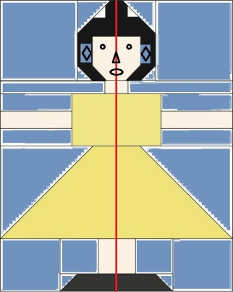
Udaan...
Experiential Programs for Corporates and Professionals
plc
People Live Consultants
Corporate trainers and HR Advisors
Valley of the Dolls
Achieve desired result through collaboration… Everytime…
How does it work?
This is a team game where the teams are split into 2 groups and given a task which requires assembling the raw material and equipment to achieve the objective. Both the groups have to come together and act in harmony to achieve the task. It again requires precise planning from the team and its leader, otherwise it could be no show. Throughout this 2 hour experience, the participants will:
Experience an ever changing environment
Encounter time pressure
Utilize the skills and resources of the team members as effectively as possible
Improve efficiency by having the right people and resources in place
What do participants learn?
How to work under timelines and pressure
Understanding the task and communicating within the team
Allocating the task as per individual skills
Importance of asking questions
Importance of team work and also understanding the competition
Size of the participants: Maximum – 30
Program Duration: Half day (4 – 5 Hours)

Slide 3
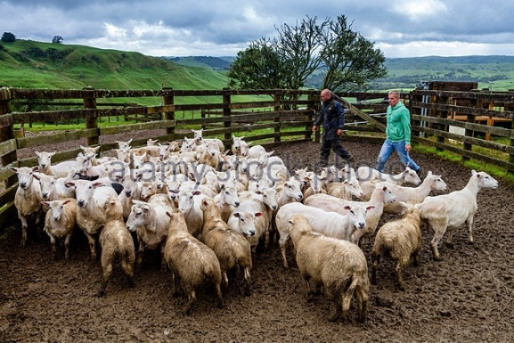
Udaan...
Experiential Programs for Corporates and Professionals
plc
People Live Consultants
Corporate trainers and HR Advisors
Herding the Sheep…
Listen to understand and not to reply…
How does it work?
Participants take part in a unique blend of sound and rhythm made from the most surprising objects and quickly learn the value of individual contribution and personal accountability and the need to work in harmony to achieve the desired results. It provides great lesson in leadership, planning, execution, rehearsing, asking questions, to achieve the given task which will test everyone in the team.
It is a 90 minute fun exercise where participants follow instructions given by unusual instruments to achieve the task. This is usually preceded by ice breaking and an exercise on communication to set the tone of the program.
What do the participants learn?
The program provides a strong and immediate message of the value of individual contribution in working in harmony
Participants discover how to look at things from new angles and approach and once the approach is decided, how to practice it and put it into execution
Finally, working together to achieve the task
Key take away: Precision in planning and execution
Size of the participants: Maximum – 30
Program Duration: Half day (4 – 5 Hours)

Slide 4
Udaan...
Experiential Programs for Corporates and Professionals
plc
People Live Consultants
Corporate trainers and HR Advisors
News Room…
Everybody should be on the same page…
How does it work?
As the editor of your newspaper, you have to gather news for different pages and edit the same. Two teams have to get together to make a 8 page newspaper so that it is a complete newspaper with the given resources, headings and sections with no duplication and mismatch in any of the sections. Everyone has to get together to align and meet the deadlines.
In this full day program, participants experience the highs and lows of communication and asking questions till there is absolute clarity and understanding of the task besides the role of the leader which is key to the exercise. While going through the task and the related pressure of timelines, participants also experience the wisdom of sharing information and helping others to achieve the objective.
What do the participants learn?
Key learning points include:
Effective communication delivers exceptional results
Listening to understand, not to reply
Helping others
Team work and collaboration
Good participants push the leader to perform
Size of the participants: Maximum – 30
Program Duration: Half day (4 – 5 Hours)

Slide 5
Udaan...
Experiential Programs for Corporates and Professionals
plc
People Live Consultants
Corporate trainers and HR Advisors
Failing to plan is planning to fail…
How does it work?
Team leader acts like a movie producer and director who is required to assemble the necessary resources to create a short movie on a given topic while engaging the audience’s attention and eyeballs. This is the last exercise of the day and the time allocated is 120 minutes. Participants will experience the following outcomes:
Team work and collaboration with proper planning
Optimal allocation of resources
Effective communication and conflict resolution
Working within constraints to achieve the desired results
Add value in creative ways to maximize the impact
What do the participants learn?
Participants learn to execute the plan and course of action to achieve the desired result.
Utilizing the available resources for desired communication.
Leadership where team leaders understand individual strengths before allocating specific tasks (Right person for the right job).
Key learning points: Clear communication and task allocation preceded with precision in planning.
Size of the participants: Maximum – 30
Program Duration: Half day (4 – 5 Hours)

Slide 6
Udaan...
Experiential Programs for Corporates and Professionals
plc
People Live Consultants
Corporate trainers and HR Advisors
Air Force 1
A goal without a plan is just a wish…
How does it work?
A situation is given to the participants where after the mid air crash, survivors and dead bodies are scattered all over a defined area and have to be retrieved within specified time including important documents and “black box” intact. Success in this challenge requires careful planning, precise execution and deployment of right manpower to execute the given task. Communication and Team work is the key.
In this full day program, the outcome is in the form of:
Importance of planning and work allocation
Improved use of information
Efficient use of resources
Achieving the desired results within timelines
What do the participants learn?
Learning points of this exercise:
Participants learn to ask questions till the task is clearly understood
Importance of planning (Option of plan B)
Clearly defining “who has to do what” by the team leader
Every team member should know their assigned roles
Communication should never break down
Size of the participants: Maximum – 30
Program Duration: One day (8 – 10 Hours)

Slide 7
Udaan...
Experiential Programs for Corporates and Professionals
plc
People Live Consultants
Corporate trainers and HR Advisors
Bridge on the River Kwai
Achieve big things through team collaboration…
How does it work?
Participants must build a bridge on the river Kwai which is suffering from tourist inflow from boats and yachts, eager to observe the marine wildlife in the area. To keep the area safe from noise and fuel pollution, participants in small teams have to build separate sections of the bridge and ultimately join their sections together to deliver the final product. Besides the other exercises, this is the last exercise of the program to achieve the following outcomes:
Emphasis on team work as part of small teams and larger groups.
Hands on focus on collaboration.
Focus on planning and resource allocation.
Improved communication effectiveness.
Greater alignment between different teams to achieve a common objective.
What do the participants learn?
Extend their planning horizon
Change tactics
Understand the importance of resources crucial to success
Overcome obstacles by reviewing, stopping, re-focussing and moving forward
Key Learnings: Careful planning and precision in execution
Size of the participants: Maximum – 30
Program Duration: One and a half day (12 – 14 Hours)

Slide 8
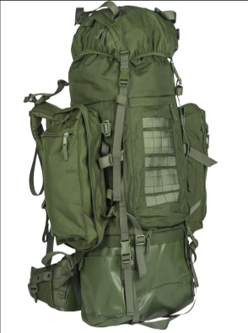
Udaan...
Experiential Programs for Corporates and Professionals
plc
People Live Consultants
Corporate trainers and HR Advisors
Z KITBAG
How does it work?
Z KITBAG is an army framework or strategy on planning and execution of any military campaign in a war situation.
This framework has a parallel to competitive and ruthless corporate dog-eats-dog world.
Z KITBAG is a 2 day comprehensive outdoor workshop which is an all inclusive program. In this challenging program stretching to two days, the participants experience the importance of planning, execution, teamwork and collaboration, out of box thinking and finally leadership to achieve the objective.
What do the participants learn?
Communication & Planning is the key to execute any task.
If option A does not work, have a plan B in place.
Allocation of resources within given constraints.
Identify the right people for the job.
Ask questions till you have the clarity of the task.
Review, retract, reorganize, but don’t give up.
Respect dissenting voice.
Involve everybody in the team and give everyone a task so that everyone is constructively engaged (An idle mind is a destructive mind).
If required, think out of the box and innovate.
Finally, leadership is all about influence, not authority.
Size of the participants: Maximum – 40
Program Duration: Two days outdoor / indoor (16 – 18 Hours)
Z
KIT
BAG

